Slide 1
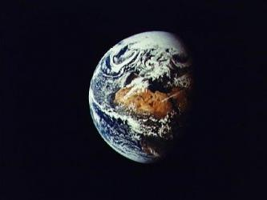
August 26-27, 2011
Rev. Gail Collins-Ranadive
Milt Hetrick
Awakening the Cosmos Within:
Preparing Ourselves for the Great Work of Our Era

Slide 2
Awakening the Cosmos Within:
Preparing Ourselves for the Great Work of Our Era
Rev. Gail Collins-Ranadive
Milt Hetrick
Friday Evening
Ingathering/Overview 7:00 PM
The Universe Story/ Big History/ Epic of Evolution/ History of Nature Slide Show (Milt)
– Going Back 13.7 Billion Years
“Out of the Stars” by Robert Weston Reading 8:00 PM
Discerning your Elemental Self: Light, Earth, Air, Water Writing Exercise (Gail)
Saturday Morning
Opening and Check In 9:00 AM
Embedding ourselves in the Story: Writing Exercises (Gail)
Cosmic Differentiation, Subjectivity, Communion
Time’s Dimensions: Everyday, Eternal, Emergent
Deep Time / Sacred Space / Quantum Self
Reframing Past, Present, Future
Lunch 1-1:30 PM

Slide 3
Awakening the Cosmos Within:
Preparing Ourselves for the Great Work of Our Era
Saturday Afternoon
What is the Universe Telling Us?
  General Observations from the Universe Story Presentation (Milt) 1:30 PM
    Expanding, Cooling, Calming, Emergence, Creativity, Complexity, Cooperation
  Energy Transformation / Life as the Flow of Energy
    From Light to Matter to Living Organisms to Differentiated Consciousness
  Tree of Life / Right Relationships
  Spaceship Earth / Finiteness of Ancient Energy Resources / Infinite Recycling of other Resources
  Reflections about the New Knowing Writing Exercise (Gail) 2:00 PM
What are 7 Billion Humans Doing?
  Yesterday’s Successes/Today’s Issues/Tomorrow’s Challenges Presentation (Milt) 2:15 PM
  Ecomorality – the Ethics of Sustainability
  – an evolving tool for approaching tomorrow’s challenges
  Reflections on an Ethic of Sustainability Writing Exercise (Gail) 2:45 PM
  People & Organizations that Can Help You / that Need Your Help
    Blessed Unrest (Global) Presentation (Milt) 3:00 PM
    Re-build the Dream - Van Jones (National)
    Ministry for Earth / Green Sanctuary (UUA)
    Green First Teams / Social Justice Task Forces (First Universalist)
    A Typical Personal Path
So What Does Your Element Want of You? Writing Exercise (Gail) 3:15 PM
Closing 3:30 PM
Overview of Part 3

Slide 4
Terminology
Emergence: Something more (complex) from nothing but (what already exists) as a result of new relationships
  Example: Water(H₂O) is something more from nothing but H & O
  Example: A book is something more from nothing but words in new relationship
  Example: A nation is something more from nothing but people in a new relationship
Evolving Complexity – the result of sustainable Emergence – the direction of the Universe
Relationships – combinations of subjects coming together by an Attraction
Attraction (natural) – 4 forces that help us describe observable nature
  Strong Nuclear Forces
  Weak Nuclear Forces
  Gravitational Forces (Astrophysics, Cosmology,…)
  Electromagnetic Forces (Chemistry, Biology,…)
Energy – many forms - including “light”

Slide 5
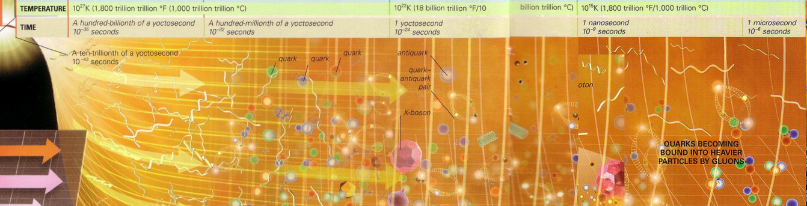
In the beginning, GOD created the heavens and the earth…. and GOD said “Let there be light,” and there was light.
– Genesis 1:1-3
Ref: Universe: The Definitive Visual Guide, DK Publishing, New York, 2008
Light flaring forth
13.7 billion years ago ….
Expanding…
Cooling…
Light (Energy) transforming into Matter…
Matter transforming back into light…
E = mc²…
Emergence of things like Strings,
Expanding…
Cooling…
Allowing the Emergence of Complexity…
Quarks, and Anti-Quarks,
X-Bosons and Anti -X-Bosons…
the light / elemental particle soup…
Notes:
Ref: Universe: The Definitive Visual Guide, DK Publishing, New York, 2008

Slide 6
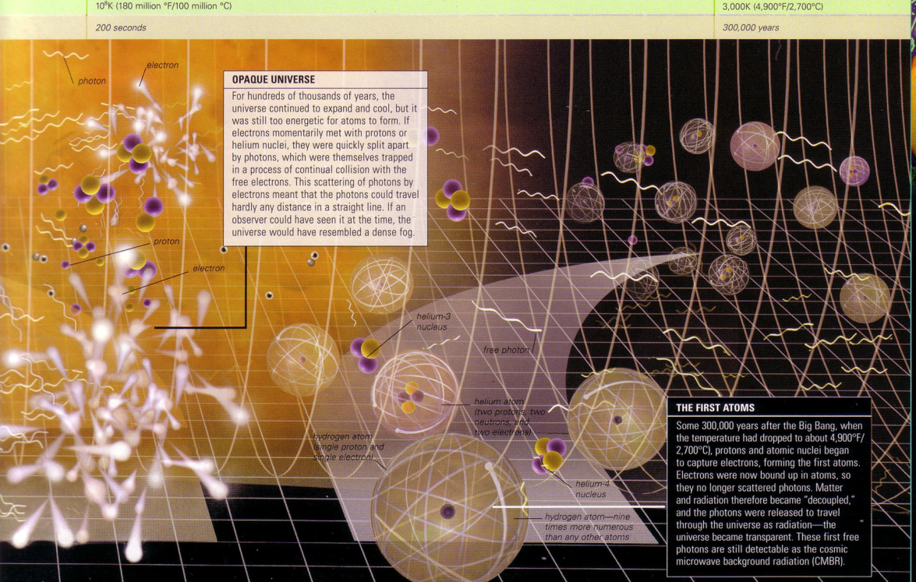
Expansion and cooling for 380,000 years…
Until Attraction between elemental particles creates more complex matter…
- the basic building blocks of all the mass we now see in the
Universe emerges… the atoms of Hydrogen (76%) and Helium (24%)
(4900 ° F /2700 °C)
Ref: Universe: The Definitive Visual Guide, DK Publishing, New York, 2008

Slide 7
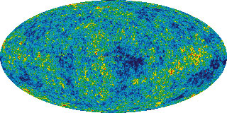
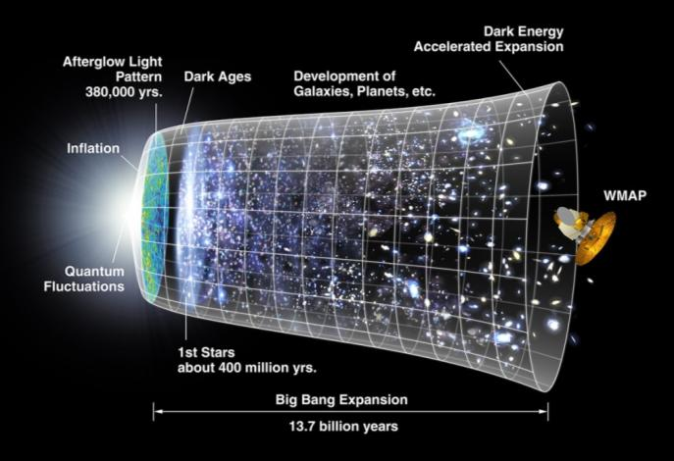

Wilkinson Microwave Anisotropy Probe (WMAP)
NASA's WMAP spacecraft mapped the Cosmic Microwave Background (CMB) radiation (the oldest light in the universe).
Data from the Spacecraft indicates:
  the age of the universe is 13.73 billion years old
  ordinary atoms (also called baryons) make up only 4.6% of the universe
  dark matter (not made up of atoms) make up 23.3%
  dark energy makes up 72.1% of the universe, causing the expansion rate of the universe to speed up.
"Lingering doubts about the existence of dark energy and the composition of the universe dissolved when the WMAP satellite took the most detailed picture ever of the cosmic microwave background (CMB)." - Science Magazine 2003, "Breakthrough of the Year" article

Slide 8
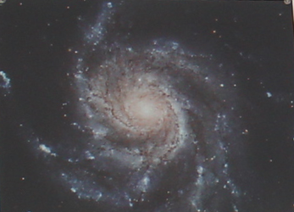
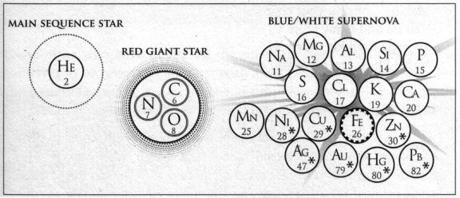
Expansion, cooling, calming for another 200 million years…
Until Attraction (now gravity) sorts the Hydrogen of the Universe…
Into 10-100 billion galaxies so stars can be born…
Each galaxy containing 10-100 billion stars (Gravity centers)
Including Red Giants, Supernovas…
The furnaces that transform Hydrogen into Helium,
Carbon, Nitrogen, Oxygen,
And all the elements of the Universe
Hydrogen 74%
Helium 23%
Oxygen 1%
Carbon 0.5%
Iron 0.1%
Nitrogen 0.1%
+ trace elements
Nucleosynthesis
Light, and the basic elements for Air, Water and Earth now appear
See: Wonders of the Universe, Brian Cox, 2011

Slide 9
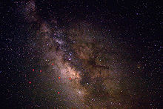

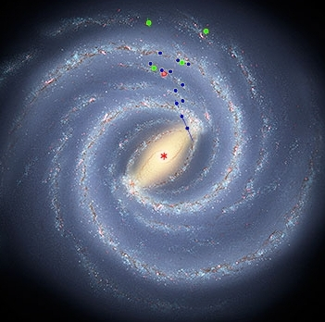
As we gaze toward the constellation Sagittarius…
We are peering into the center of the Milky Way Galaxy…
Our spiraling extended family of star stuff…
Our Solar System is about 28,000 light-years from the Milky Way's center. We're moving at about 600,000 miles per hour in our Galactic orbit.
Artist's Conception of our Milky Way Galaxy

Slide 10
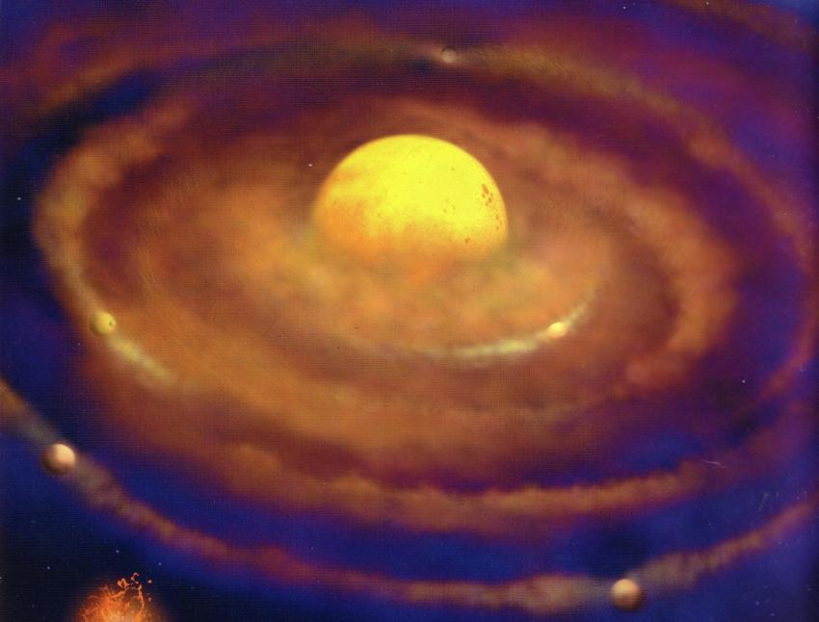
4.5 billion years ago…
Within the Milky Way…
A new Emergence – something more complex from nothing but star stuff – the consequence of Gravity…
Our Solar System - our Sun, our Planet Earth, our Moon and sister planets
How Fast is the Earth Moving?
1,000 | mph | At the equator about the axis of the Earth
67,000 | mph | Orbiting about the Sun
600,000 | mph | Orbiting about the center of the Milky Way
2,236,936 | mph | Milky Way rushing toward the Great Attractor
870,000 | mph | Relative to the CBR toward the constellation Leo

Slide 11
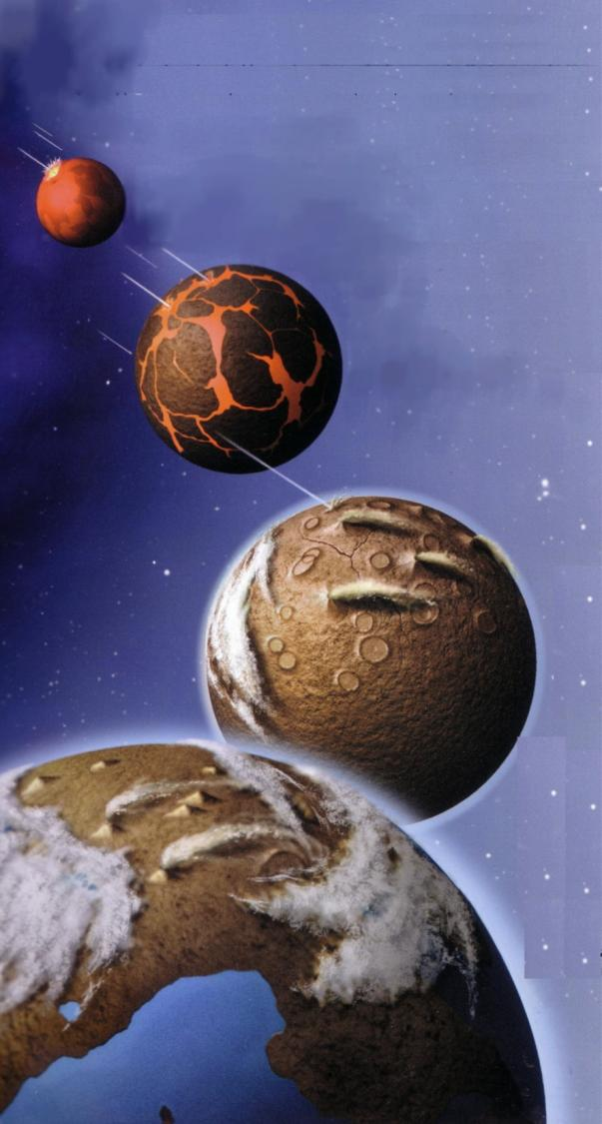

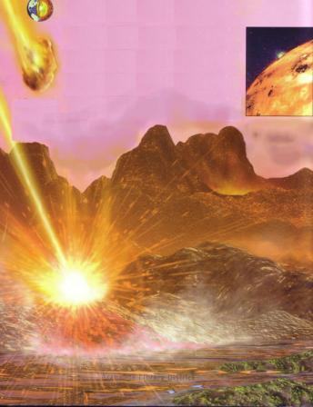
4.5 billion years ago…
Planet Earth cooling, calming,
A Goldilocks collection of Star Stuff (over a hundred elements)
Especially CHNOPS – the basics for Life
all in a liquid sea to form new relationships…
More Emergence… atoms coming together to create new
molecules beyond H₂O, N₂, O₂, CO₂ …..
…. the miracle we call chemistry

Slide 12
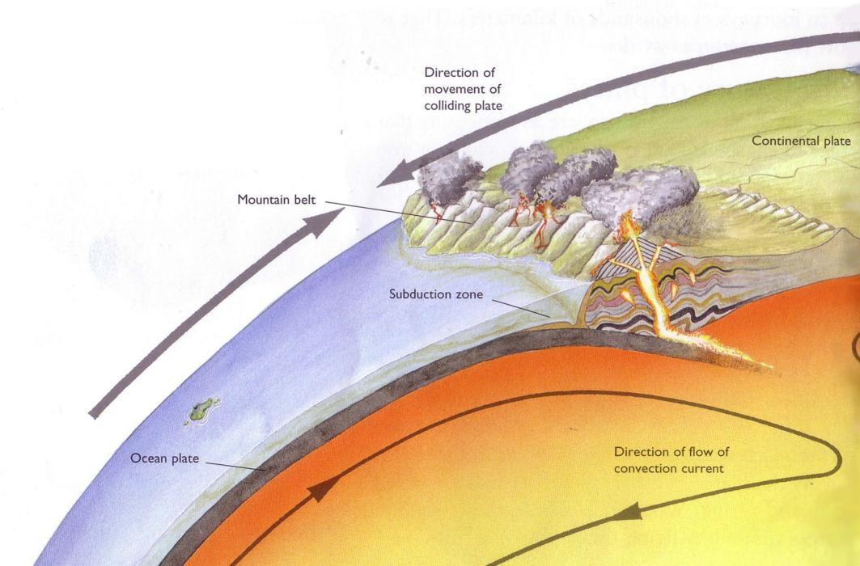
Still cooling, calming…
Land and air and water - bathed in sunlight …
coming together in a complex relationship
giving birth to Planet Earth
And creating a birthplace for Life

Slide 13
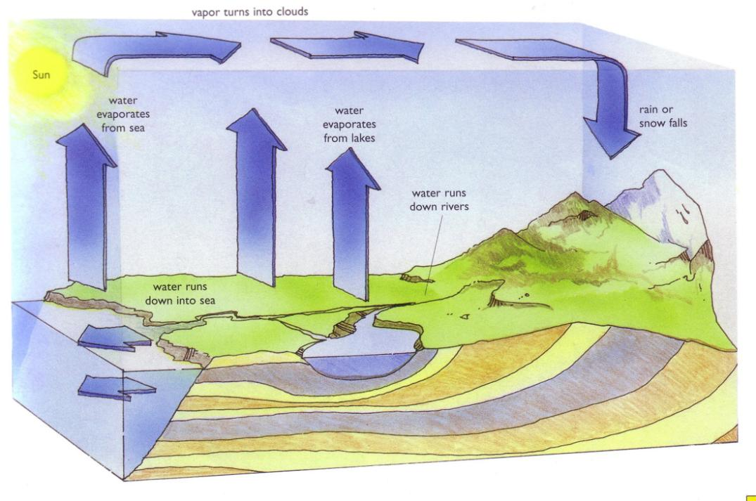
As Planet Earth cooled, rotated on its 24 degree tilted axis,
and revolved around the Sun,
our daily and seasonal communion with Sun began….
Gaia was awakened …
And responded to the daily gift of persistent Sunlight…
The Cycles began – wind, rain, ocean currents…

Slide 14
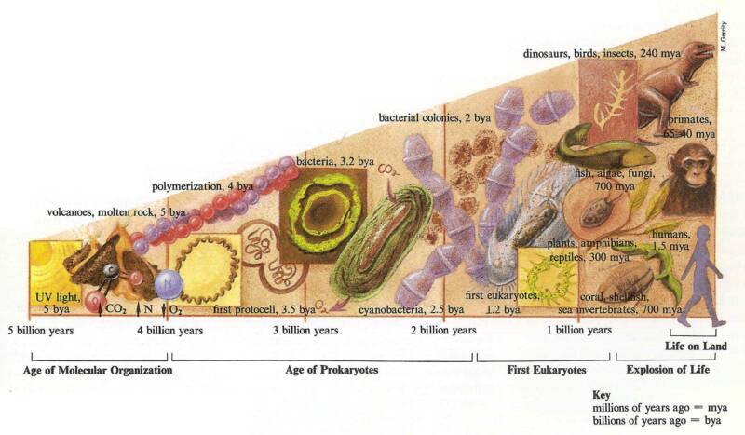
Emergence continues – creating more complex molecules from nothing but primordial Hydrogen and the elements of other stars.
We follow the DNA trail of Complexity…
from the miracle of cellular Life 3.5 billion years ago
to multi-cell Life (Eukaryotes) 1.2 billion years ago
to sea coral, fish (700mya), plants (300mya)

Slide 15
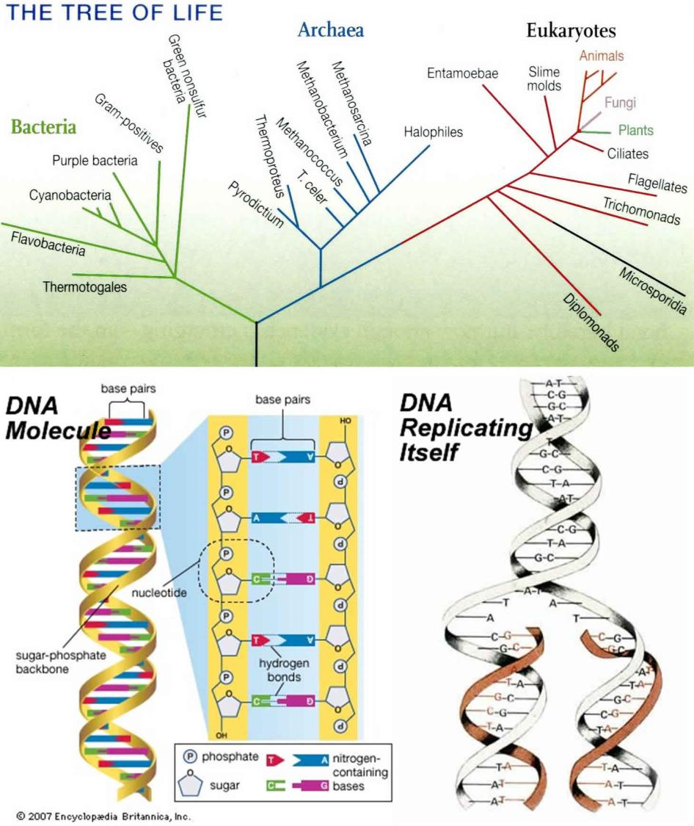
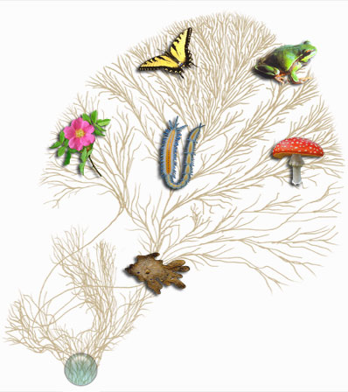
The Phylogenetic Tree of Life
based on the evolution of DNA

Slide 16
… all the creatures on this planet share striking commonalities even as they diverged for over 3 billion years
All have genomes inscribed in DNA that use the same triplet genetic code;
all share metabolic pathways and patterns of protein synthesis;
all use many of the same protein building blocks; the list is very long.
…some 3 billion years ago, a group of single-celled creatures come up with a core set of arrangements for generating cells that was then utilized by all subsequent evolutionary lines as they moved into every corner and crevice of the planet, novelty upon novelty, extinction upon extinction, generating the web [The Tree of Life] we now behold and within which we are embedded….. Ursula Goodenough
[Ref: Chapter 30: Ecomorality: Toward Ethics of Sustainability, by Ursula Goodenough; from “A Pivotal Moment: Population, Justice & the Environmental Challenge,” edited by Laurie Mazer. ]

Slide 17
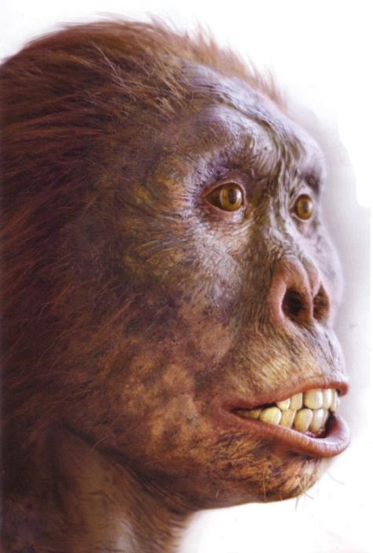

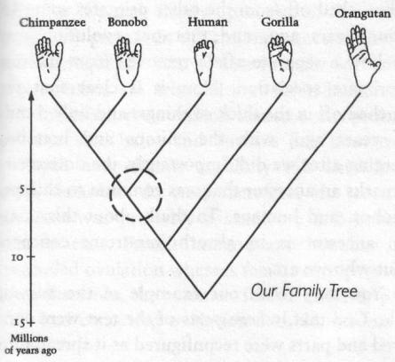
We share 95 per cent of our genetic material with our closest
living relatives, chimps [Ref 1].
Our oldest modern human ancestors were in Africa
200,000 years ago. [Ref 2]
Ref 1: Roy Britten , California Institute of Technology,
Proceedings of the National Academy of Sciences (DOI: 10.1073/pnas.172510699
Ref 2: 2006 National Geographic Society

Slide 18
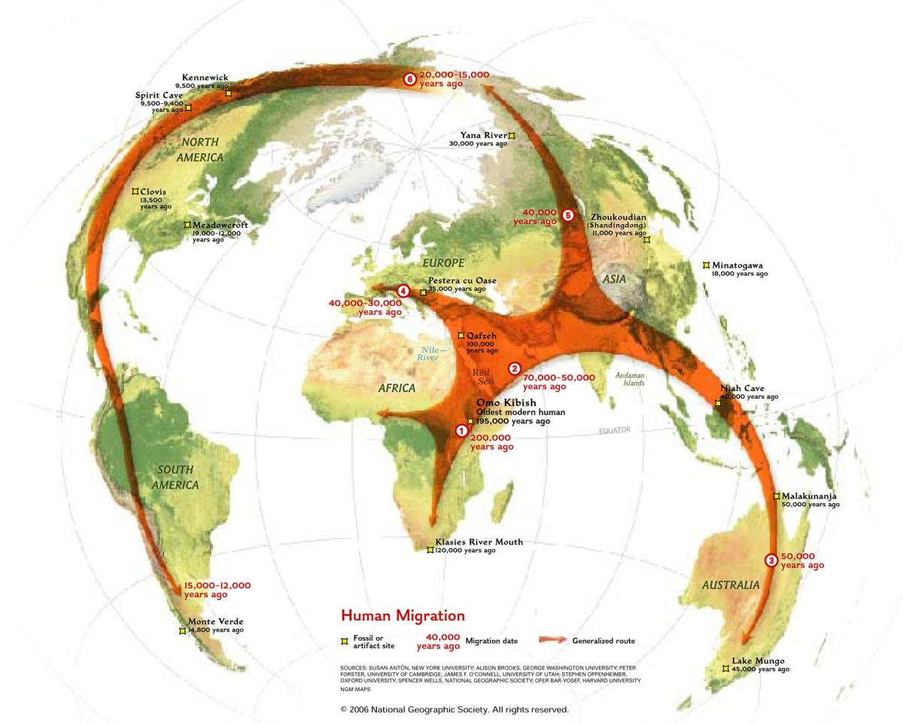
Modern Humans - Out of Africa…
Into Europe 30,000-40,000 years ago…
Into North America 15,000-20,000 years ago…

Slide 19
Terminology
Emergence: Something more (complex) from nothing but (what already exists) as a result of new relationships
  Example: Water(H₂O) is something more from nothing but H & O
  Example: A nation is something more from nothing but people in a new relationship
Attraction (natural) – 4 forces that help us describe observable nature
  Strong Nuclear Forces, Weak Nuclear Forces, Gravitational Forces (Astrophysics, Cosmology,…), Electromagnetic Forces (Chemistry, Biology,…)
  Note: 95.4% of the Cosmos is not observable and referred to as “dark matter” & “dark energy” The observable 4.6% is directly traceable back 13.7 billion years to the initial Light. Everything observable might be considered the Children of the Light.
Attraction (natural with help from humans)
  Emergence of Tools: a natural piece of flint chipped away to expose a sharp cutting edge
  Emergence of New Materials: Bring Iron together with 11% Chromium to make Stainless Steel
  Emergence of New Stuff: Just look around
Attraction (human based) – innumerable “forces of attraction” created by conscious beings
  Examples: Family Bonds, National Fervor, Religious Beliefs

Slide 20
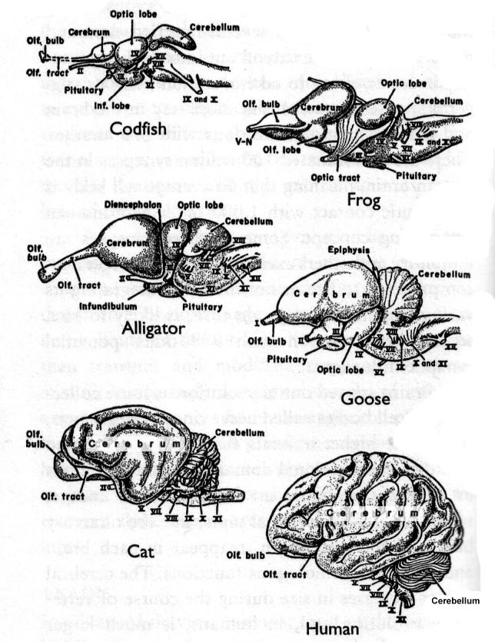
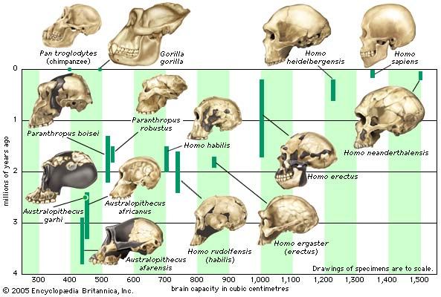
We have evolved with a brain to be the “eye”…
of the Planet, of the Solar System, and more?
Nature’s 13.7 billion year plan to convert light
into consciousness.

Slide 21
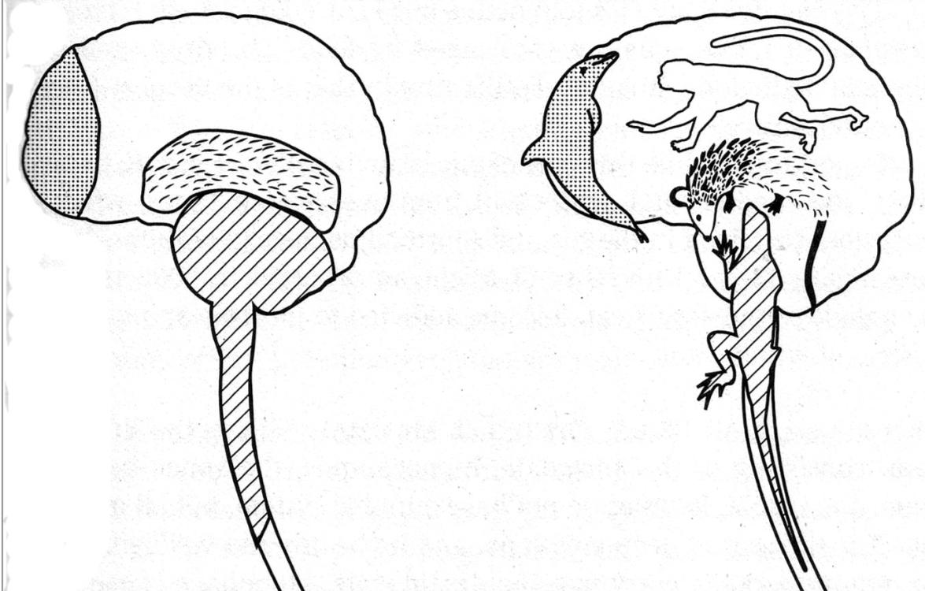
Michael Dowd’s Quadrune Brain Graphic
neo-mammalian
Monkey-Mind
Prefrontal-cortex
Higher-Porpoise
Paleo-mammalian
Furry Li’l Mammal
Reptilian
Lizard Legacy
Ancient reptilian brain— our Lizard Legacy:
Our deepest, oldest brain components (and behavioral drives)
Paleomammalian brain, the limbic system — our Furry Li’l Mammal:
Seat of emotions, and experiential learning
Neomammalian brain, our neocortex - our talkative Monkey Mind:
Our chatter box, calculating brain, always talking to itself, choosing
Neocortex at our forehead, left and right frontal lobes— our Higher Porpoise:
Last to evolve, the seat of our higher purpose, intentionality, complex-decision making

Slide 22
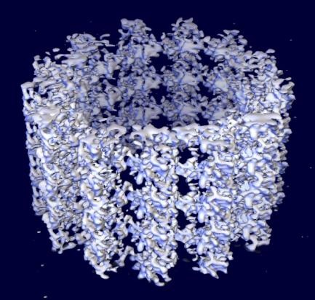
Neurophysiological Explanations of Consciousness
( Hameroff & Penrose)
The human species has evolved to be a self-aware being.
Through collective learning, we are able to pass along knowledge from generation to generation.
Human consciousness continues to evolve.
The human quest for knowledge and understanding continues as researchers explore the link between the physical neurological structure of the brain and the intangible mind associated with human consciousness.
More Emergence….as a result of combining quantum physics and neurophysiology
Hameroff & Penrose propose that aspects of quantum theory (e.g. quantum coherence) and of a newly proposed physical phenomenon of quantum wave function “self-collapse”(objective reduction) are essential for consciousness. Furthermore, it appears this process can occur in cytoskeleton microtubules and other structures small enough to be driven by quantum effects within each of the brain’s neurons.
For details see: Quantum Consciousness
(http://www.quantumconsciousness.org/penrose-hameroff/consciousevents.html)

Slide 23
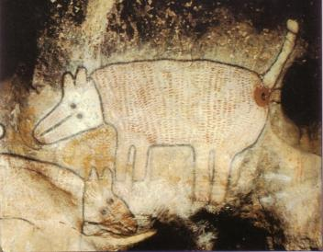
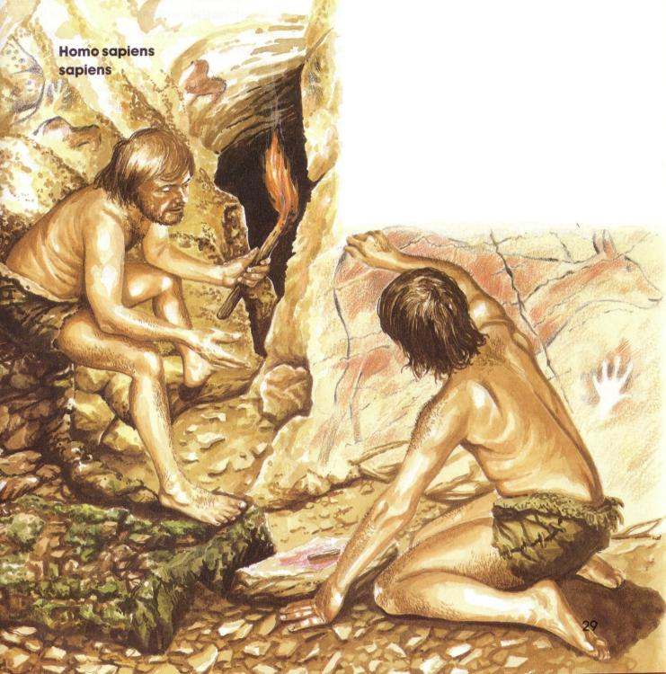
Cave Art has been dated to 20,000 years ago…
Evidence of abstract awareness
and the ability to communicate…
Consciousness unfolding.

Slide 24


After following migrating herds…
and domesticating animals(sheep, goats)…
We learned to plant and harvest crops – the dawning of Agriculture gives rise to settlements & cities

Slide 25
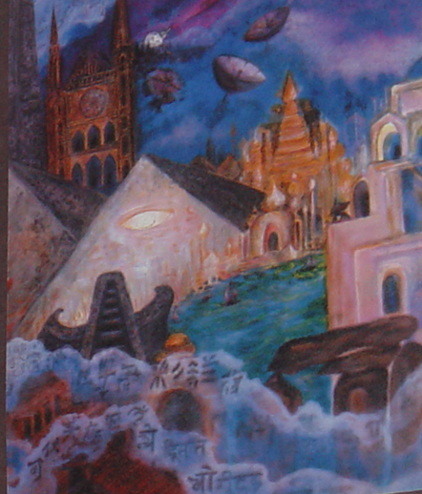
Humans consciously join together in cooperation to
form complex social orders…
Emergence continues…
Complex social orders might include:
Family
Extended family
Community/Neighborhood
Businesses / Corporations
NGOs
Governments / Nation States
Law Enforcement / Military Forces
World Religions
Ref: Mammals Who Morph: The Universe Tells Our Evolution Story Jennifer Morgan(Author), Dana Lynne Andersen (Illustrator)
Notes:
Ref: Mammals Who Morph: The Universe Tells Our Evolution Story (Sharing Nature With Children Book) Jennifer Morgan(Author), Dana Lynne Andersen (Illustrator)

Slide 26
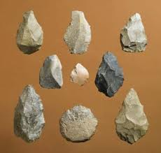
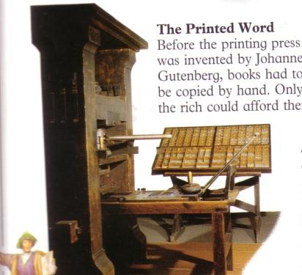
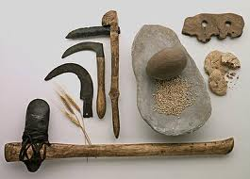
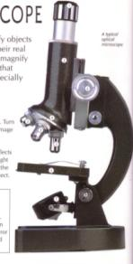

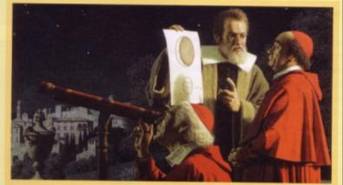
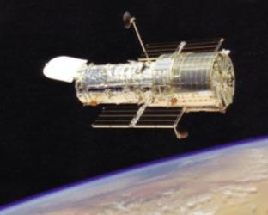
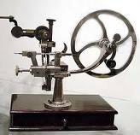
Humans continue to extend their capabilities, with “tools” shaped from the resources of the Planet.
Emergence Continues...
Tools are now called Technology…

Slide 27
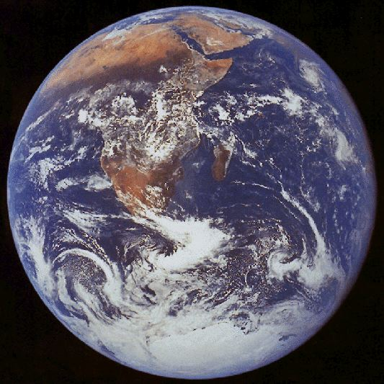
Planet Earth…
Africa – origin of Modern Humans
Basking in Sunlight
Through a paper thin frosting
Of Air and whimsical wandering clouds of Water
Sunlight
Air
Water
Earth
View from Apollo 17 :
Last Human Trip to Moon, Dec. 7, 1972

Slide 28
Out of the Stars
Robert Weston
Out of the stars in their flight, out of the dust of eternity,
here have we come,
Stardust and sunlight,
mingling through time and through space.
Out of the stars have we come,
up from time.
Out of the stars have we come.
Time out of time before time
in the vastness of space,
earth spun to orbit the sun,
Earth with the thunder of mountains newborn,
the boiling of seas.
Earth warmed by sun, lit by sunlight;
This is our home;
Out of the stars have we come.
Mystery hidden in mystery,
back through all time;
Mystery rising from rocks
in the storm and the sea.
Out of the stars, rising from rocks
and the sea,
kindled by sunlight on earth,
arose life.
Ponder this thing in your heart,
life up from sea:
Eyes to behold, throats to sing,
mates to love.
Life from the sea, warmed by sun,
washed by rain,
life from within, giving birth,
rose to love.
This is the wonder of time;
this is the marvel of space;
out of the stars swung the earth;
life upon earth rose to love.
This is the marvel of life,
rising to see and to know;
Out of your heart, cry wonder:
sing that we live.

Slide 29
Discerning your Elemental Self: Light, Earth, Air, Water
Writing Exercise

Slide 30
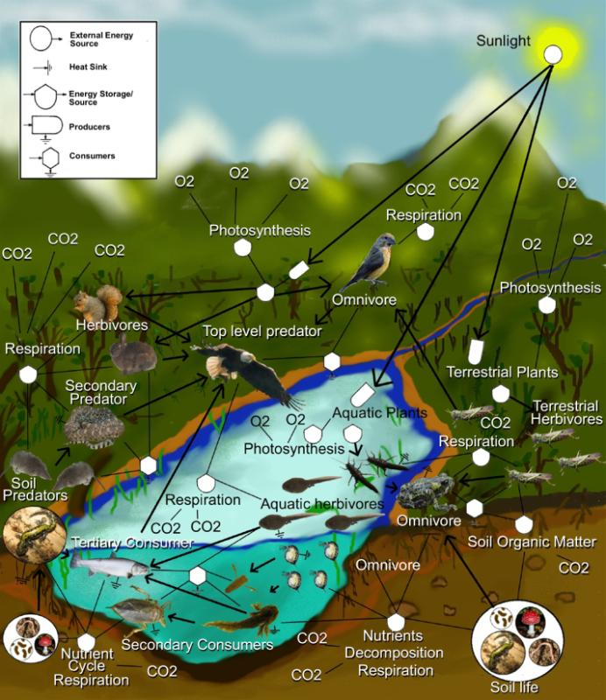
All Life on Planet Earth is linked to
Current Light from the Sun, and rooted in a
Healthy Planet - all in Right Relationship
Our Life and Evolving Consciousness
depends on all non-human Life - its that simple
“With the rise of modern sciences we began to think of the Universe as a collection of objects rather than a communion of subjects…”
…In realty there is a single integral community of the Earth that includes all its component members whether human or other.”
This is our Great Work – to create a “mutually enhancing human presence within an ever-renewing organic-based Earth community” (Thomas Berry)

Slide 31
Conclusions / Summary
Everybody’s Story - The Universe Story - The Epic of Evolution - The History of Nature
After hearing this Story, it is difficult not to be changed forever
  We become aware that we are not only related to every other human on the Planet, but also to every animal and every plant and every living entity. WE ARE FAMILY
  We become aware that every atom in our body is a part of the Earth family that is a part of our Solar family of star stuff.
  We become aware how we are inextricably tied into the Light that was the beginning.
The Story tells us that for 13.7 billion years the Universe has been consistently expanding, cooling, calming, coalescing and creating more and more complexity and consciousness
  Emergence : Something More from Nothing But …as a result of new Relationships
  Natural Attractive Forces that form new relationships
  (weak and strong nuclear forces, gravitational force, electromagnetic force)
  Human Attractive Forces that form new relationships
  (Survival, Love, Fear, Family, Nationality, …)
The story also tells of our Evolving Consciousness
  We self-aware beings have become an individuated “I”
  We have also become an “Eye” for Planet Earth, our Solar System and the entire Cosmos.
  What we 7 billion humans do (and don’t do) with what we now can see using this new Eye determines our future and the evolution of Planet Earth.
The story tells us our future is our conscious choice (and responsibility?) The sane choice is of course to choose Sustainability and adopt a new paradigm – Ecomorality: The Ethics of Sustainability and Evolving Consciousness.

Slide 32
Resources (Used by Gail)
Augros, Robert & Stanciu, George. The New Story of Science. New York: Bantam
Books, 1984.
Berry, Thomas. The Dream of the Earth. San Francisco: Sierra Club Books, 1988.
Berry, Thomas. The Great Work. New York: Bell Tower, 1999.
Dowd, Michael. Thank God for Evolution. San Francisco: Council Oak Books, 2007.
Goswami, Amit. The Self-Aware Universe. NY: Putnam, 1993.
O’Murchu, Diarmuid. Evolutionary Faith. New York: Orbis, 2002.
Quantum Theology. NY: Crossroads, 2004.
Ancestral Grace. New York: Orbis, 2008.
Palmer, Parker. Let Your Life Speak. San Francisco: Jossey-Bass, 2000.
Spretnak, Charlene. States of Grace. NY: HarperCollins, 1991.
Swimme, Brian. The Hidden Heart of the Cosmos. New York: Orbis, 1996.
The Universe is a Green Dragon. Vermont: Bear & Co., 2001.
Swimme, Brian and Thomas Berry. The Universe Story. New York: HarperCollins, 1994.
Yungblut, John R.. The Gentle Art of Spiritual Guidance. Rockport: Element Press 1988

Slide 33
Resources (Used by Milt)
Benyus, Janine. Biomimicry: Innovation Inspired by Nature, Harper Perennial, 2002.
Brown, Cynthia Stokes. Big History: From the Big Bang to the Present. The New Press, 2007.
Chaisson, Eric. Epic of Evolution: Seven Ages of the Cosmos. Columbia University Press, 2005
Chamberlin, Shaun. The Transition Timeline: For a local, resilient Future.
Chelsea Green Publishing, 2009.
Christian, David. Maps of Time: An Introduction to Big History. University of California Press, 2005.
Cohen-Kiener, Andrea. Claiming Earth as Common Ground : The Ecological Crisis through the Lens of Faith. Skylight Paths Publishing, 2009.
Corzine, Amy. The Secret Life of the Universe: The Quest for the Soul of Science.
Watkins Publishing, 2008.
Ferris, Timothy. Coming of Age in the Milky Way. Perennial, 2003.
Korten, David. Agenda for a New Economy: From Phantom Wealth to Real Wealth – Why Wall Street
Can’t be Fixed and How to Replace it. BK Publishers, 2009.
Kowalski, Gary. Science and the Search for God. Lantern /books, 2003.
McDonough, William & Michael Braungart. Cradle to Cradle: Remaking the Way We Make Things. North Point Press, 2002.
Nierenberg, Danielle & Brian Halweil,. 2011 State of the World: Innovations that Nourish the Planet, Worldwatch Institute Report, W. W. Norton & Company, 2011.
Rue, Loyal. Everybody’s Story: Wising Up to the Epic of Evolution.
State University of New York Press, 2000.
Schuler, Michael. Making the Good Life Last: Four Keys to Sustainable Living. BK Publishers, 2009.
Smith, Philip & Manfred Max-Neef. Economics Unmasked : From Power and Greed to Compassion and the Common Good. Green Book, 2011.
Wells, Spencer. The Journey of Man: A Genetic Odyssey. Random House, 2003

