Slide 1
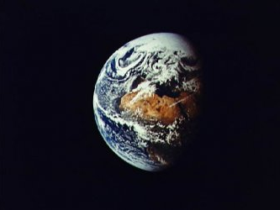
August 26-27, 2011
Rev. Gail Collins-Ranadive
Milt Hetrick
Awakening the Cosmos Within:
Preparing Ourselves for the Great Work of Our Era

Slide 2
Awakening the Cosmos Within:
Preparing Ourselves for the Great Work of Our Era
Saturday Afternoon 1:30 PM
What is the Universe Telling Us?
  General Observations from the Universe Story Presentation (Milt) 1:30 PM
    Expanding, Cooling, Calming, Emergence, Creativity, Complexity, Cooperation
  Energy Transformation / Life as the Flow of Energy
    From Light to Matter to Living Organisms to Differentiated Consciousness
  Tree of Life / Right Relationships
  Spaceship Earth / Finiteness of Ancient Energy Resources / Infinite Recycling of other Resources
  Reflections about the New Knowing Writing Exercise (Gail) 2:00 PM
What are 7 Billion Humans Doing?
  Yesterday’s Successes/Today’s Issues/Tomorrow’s Challenges Presentation (Milt) 2:15 PM
  Ecomorality – the Ethics of Sustainability
  – an evolving tool for approaching tomorrow’s challenges
  Reflections on an Ethic of Sustainability Writing Exercise (Gail) 2:45 PM
  People & Organizations that Can Help You / that Need Your Help
    Blessed Unrest (Global) Presentation (Milt) 3:00 PM
    Re-build the Dream - Van Jones (National)
    Ministry for Earth / Green Sanctuary (UUA)
    Green First Teams / Social Justice Task Forces (First Universalist)
    A Typical Personal Path
So What Does Your Element Want of You? Writing Exercise (Gail) 3:15 PM
Closing 3:30 PM
Overview of Part 3

Slide 3
Recap / Introduction to Part 3
We presented a summary of the Universe Story – focusing on our current understanding of where we came from – a Story of the Cosmos that takes us back 13.7 Billion years. In the process, we highlighted the history of each of the four poetic “elements” (water, air, earth, light) . [Cosmology]
You selected one of the four “elements” that seemed to best represent you.
You engaged in writing exercises to deepen your awareness of this “element” so that you can be this element’s “eye” and also be its voice. [Psychology / Spirituality]
We will now re-examine the Universe Story, focusing on the significant trends / tendencies / patterns / directions the Cosmos has been taking for 13.7 billion years. We will then examine a few human creations for comparison – just to get a sense of whether we humans are listening to what the Cosmos is telling us. [Sociology]

Slide 4
What is the Universe Telling Us?
General Observations from the Universe Story
This is a story of how energy (light) burst forth to display its creativity
  In the beginning there was Light
  The Story shows how Light transformed into matter as it expanded/cooled
  It a Story of Emergence: creating something more from nothing but by using forms of attraction to bring about new relationships
  Everything we can observe in our Universe is a Child of the Light - including ourselves.
  Note: 95.4% of the Cosmos is not observable and referred to as “dark matter” & “dark energy”
  Calming/cooling /expanding with emerging complexity - This is the direction of the Cosmos
  Creating more complexity – more complex flows of energy called Life
  Life driven by the Light (Energy Of the Sun) – evolving
  Life with evolving consciousness

Slide 5
What is the Universe Telling Us?
Energy Transformation / Life as the Flow of Energy
– From Light to Elemental Particles (strings, Bosons, Quarks, etc.)
to Simple Atoms (Hydrogen & Helium)
to complex Atoms (Carbon, Oxygen, Nitrogen, …., Iron)
to the heavy elements ( Co, Ni, Cu, Zn, U, Pu,…)
to simple molecules (H₂O, CO₂ , ….)
to complex molecules / proteins
to RNA, DNA
to single cell Archaea, Bacteria,
to multi-cell Eukaryotes
to evolving fungi, plants, animals
to humans
to consciousness
to collective consciousness
Energy Input required
to assemble and
Energy Flow required
to maintain Life
With the evolution of the human, Light has found a path to Evolving Consciousness

Slide 6
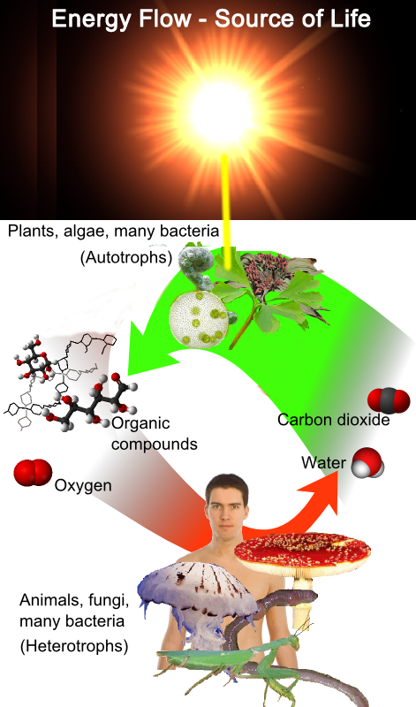
Life on Planet Earth Requires the Energy of the Sun
The Sun is our only sustainable source of energy for life on Planet Earth.
Beginning in the 1700, with the large scale mining of coal in Europe (Ancient Sunlight /fossil energy), humans started to forget their only sustainable source of life.
Over the past 300 years, we have become addicted to this one-time-only treasure of concentrated energy that has allowed us to experience a life style with a high energy intensity.
Our Sun has enough fuel for several more billion years.
Our Planet will support life for al least another 500 million years
Our current source of energy (fossil energy) will be depleted within 100 years (assuming a 1% yearly increase in consumption)
Humans can and must return to the Sun as their primary source of energy – NOW
Humans must restore Right Relations with their cousins the Photoautotrophs that convert sunlight into energy (food) for us Heterotrophs

Slide 7
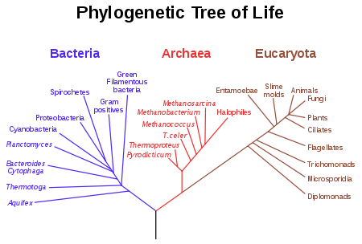
Tree of Life / Right Relations
The tree of life in science describes the relationships of all life on Earth in an evolutionary context.^{[14]}
The phrase the tree of life is often used in association with the DNA molecule.
The evolutionary relationships of the tree of life were refined using genetic data by the great American microbiologist Carl Woese, the discoverer of the domain Archaea and a pioneer in molecular (genetic) methods in evolutionary biology.
http://en.wikipedia.org/wiki/Phylogenetic_tree

Slide 8
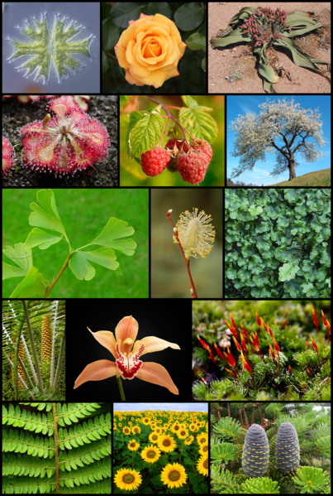
Tree of Life /
Right Relations
Those magnificent autotroph cousins that look directly at the Sun….
They are aware of their Source, they have learned to turn toward it – to reach for it – even to reflect its brilliance.
Our life totally depends on their wellness.
At this moment in human history, the awareness of our autotroph cousins demonstrates a consciousness that exceeds many of our human cousins.
But by using collective consciousness, we humans can re-learn what we once seemed to know – how to be in Right Relations with the interdependent web of life.

Slide 9
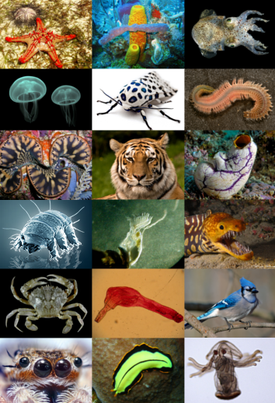
Tree of Life /
Right Relations
Our non-human heterotroph cousins are also magnificent and ever so creative in their form and function.
They too are essential threads in our interdependent web of life.
They have evolved with an awareness of their Source of life’s energy and their need to take in the energy of their autotroph or heterotroph cousins – they inherently know that standing in the Sunlight is not sufficient to stay alive.
And they are wise enough not to burn or eat Ancient Sunlight like their human cousins do.
Yes, we humans are eating Ancient Sunlight. We convert natural gas to ammonium nitrate to fertilize our fields so we can grow three times more food per acre – and we seem proud of this totally unsustainable behavior.

Slide 10
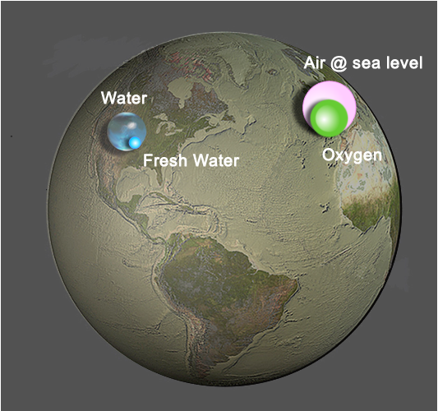
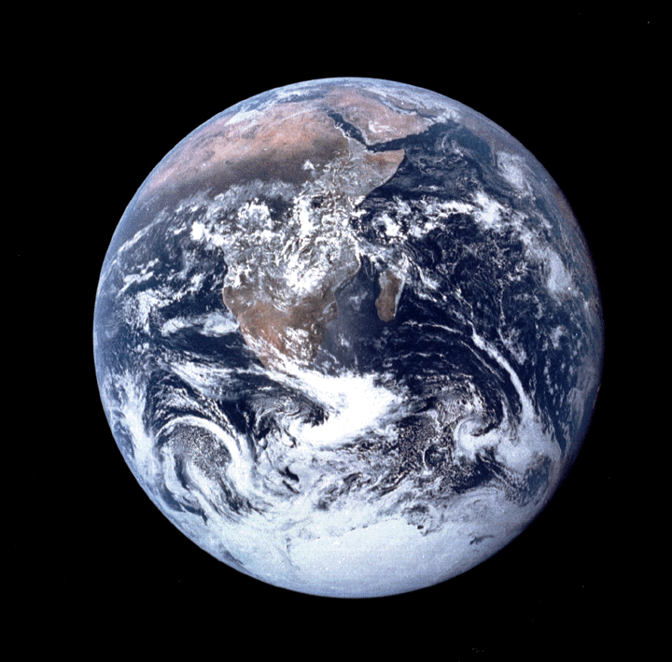
Spaceship Earth /
Finite Resources
Flat Earth with Infinite
Resources
Credit: Illustration by Jack Cook, Woods Hole Oceanographic Institution; USGS.
All the air (at sea level pressure) for Spaceship earth will fit in the pink tank – all our oxygen (21% of the air) would fit in the green tank.
7 billion humans and hundreds of billions of other living creatures large and small breath from this common supply of oxygen.
All the water for Spaceship earth is contained in the blue tank – all the “fresh” water (3% of the total water) would fit in the small green tank.
7 billion humans and hundreds of billions of other living organisms require “fresh” water for their existence – all drink from a common supply.
So why do 7 billion humans dump waste into the Planet’s critical /common Air and Water supply tanks?

Slide 11

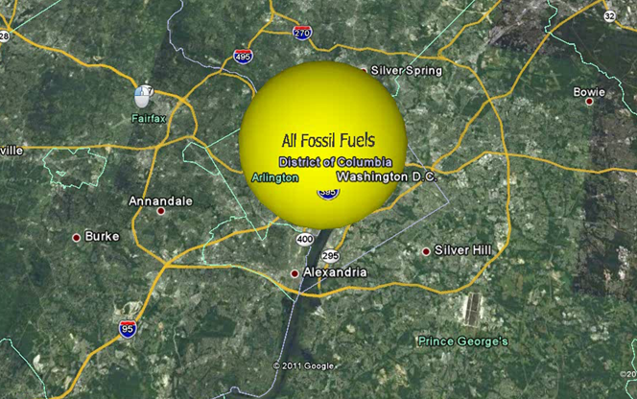
Where’s the Fuel Tank for Spaceship Earth?
Our Planet requires energy to be a living planet.
Click to Zoom Out
Our Spaceship must have a fuel tank. Where is it?
Do you see it on the right or the left?

Slide 12
Spaceship Earth / Finite Resources
Evolution is a story of Emergence:
Creating something more from nothing but as a result of new relationships.
4 forces of nature have transformed Light into Hydrogen & Helium
and then into 118 basic elements found in the Periodic Table.
These elements – star stuff - were first captured by the gravitational center we call our Sun, then re-captured by the center we call Our Planet Earth.
Earth “owns” every one of our atoms – they are here to stay.
  When we dig these atoms out of Mother Earth’s crust, we are borrowing them for our use.
  We can burn Carbon using Oxygen and make CO₂, but we do not destroy the Carbon or Oxygen atoms – they are here to stay and to be re-cycled .
Using Human consciousness , millions of creations have emerged as a result of forming new relationships with more of the basic elements available on Planet Earth. Look around you and marvel.
If human population is controlled, and if humans learn to create their food and stuff using solar energy (directly or indirectly), and if every atom that is borrowed from Mother Earth is returned/recycled after a useful life (cradle-to-cradle, not scattered or lost), then elemental resources are not consumed, just re-organized into new relationships. Then Emergence can continue as long as the Sun shines.
Borrow but Return (every atom) – Just like a library book

Slide 13
Reflections about the New Knowing
What is the Universe Telling Us?
    General Observations from the Universe Story: Emergence, Complexity, Cooperation
    Energy Transformation / Life as the Flow of Energy
    Tree of Life / Right Relationships
    Spaceship Earth / Finiteness of Ancient Energy Resources / Infinite Recycling of other Resources

Slide 14
Resources (Used by Milt)
Benyus, Janine. Biomimicry: Innovation Inspired by Nature, Harper Perennial, 2002.
Brown, Cynthia Stokes. Big History: From the Big Bang to the Present. The New Press, 2007.
Chaisson, Eric. Epic of Evolution: Seven Ages of the Cosmos. Columbia University Press, 2005
Chamberlin, Shaun. The Transition Timeline: For a local, resilient Future.
Chelsea Green Publishing, 2009.
Christian, David. Maps of Time: An Introduction to Big History. University of California Press, 2005.
Cohen-Kiener, Andrea. Claiming Earth as Common Ground : The Ecological Crisis through the Lens of Faith. Skylight Paths Publishing, 2009.
Corzine, Amy. The Secret Life of the Universe: The Quest for the Soul of Science.
Watkins Publishing, 2008.
Ferris, Timothy. Coming of Age in the Milky Way. Perennial, 2003.
Korten, David. Agenda for a New Economy: From Phantom Wealth to Real Wealth – Why Wall Street
Can’t be Fixed and How to Replace it. BK Publishers, 2009.
Kowalski, Gary. Science and the Search for God. Lantern /books, 2003.
McDonough, William & Michael Braungart. Cradle to Cradle: Remaking the Way We Make Things. North Point Press, 2002.
Nierenberg, Danielle & Brian Halweil,. 2011 State of the World: Innovations that Nourish the Planet, Worldwatch Institute Report, W. W. Norton & Company, 2011.
Rue, Loyal. Everybody’s Story: Wising Up to the Epic of Evolution.
State University of New York Press, 2000.
Schuler, Michael. Making the Good Life Last: Four Keys to Sustainable Living. BK Publishers, 2009.
Smith, Philip & Manfred Max-Neef. Economics Unmasked : From Power and Greed to Compassion and the Common Good. Green Book, 2011.
Wells, Spencer. The Journey of Man: A Genetic Odyssey. Random House, 2003

