Slide 1
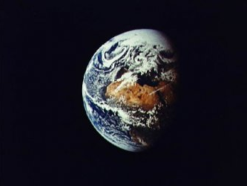
August 26-27, 2011
Rev. Gail Collins-Ranadive Milt Hetrick
Awakening the Cosmos Within: Preparing Ourselves for the Great Work of Our Era

Slide 2
What are 7 Billion Humans Doing?
Yesterday’s Successes
Careful Observation of the Universe
Collective Learning / Evolving Consciousness / Self-awareness
Cosmic consciousness (awareness of the direction of the Universe)
Evolved Abilities by means of Tools Fashioned from the Elements of the Planet (Technology)
Human Creativity / Emergence
Creating Something More from Nothing But as a result of New Relationships
Humans have created new forces of attraction that produce new relationships that create something more from nothing but
Creative Expressions (art, music, writing, entertainment,…)
New social constructs from nothing but people who are attracted together by a common concept
Creating Stuff and more Stuff
Empathy /Compassion / Connectedness
Longevity / Wellness

Slide 3
What are 7 Billion Humans Doing?
Today’s Issues (Typical)
Using outdated Ways of Thinking / Old Paradigms, Ethics & Morality
Flat Infinite Earth / Unlimited Resources / Invalid Economic Models
Loss of intimacy with the Sun – the only sustainable source of energy for life
Lack of Connection with the Deep Past / Lack of Projection into the Future
‘Consuming’ rather than ‘Borrowing and Returning’ Resources from the Planet
Lack of Empathy for Less Privileged / Silent Beings
Devaluation of Education / Collective Learning
Uncontrolled population - 7 Billion humans and growing with no end in sight
Abuse of Religious Beliefs / Political Policies
Addiction to a rapidly dwindling supply of fossil energy
Failure to observe the Universe carefully and listen to what it is telling us
Disregard for the interdependent web of all life
Failure to question media and search for the truth
Failure to recognize that the US political system has become broken
Failure to question Wall Street and hold them accountable / responsible
Failure to hold Corporations/Governments responsible for harm done to other living beings
Creating Stuff that includes Waste Products that are not the input to another process

Slide 4
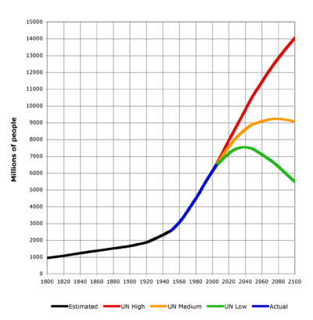
Ecomorality – the Ethics of Sustainability and Evolving Consciousness – an emerging tool for approaching tomorrow’s challenges
Issue: Human Population
After becoming conscious that the Planet Earth is finite in size and has limited resources of food, water, and fuel….
After becoming conscious that the human population on Earth must be controlled for a sustainable planet….
Isn’t it unethical to have (conceive) more than two (2) children?
Isn’t a political or religious belief system that limits means of controlling birthrate immoral?
Isn’t a tax code that rewards parents for giving birth to more than two children unethical?
Isn’t an educational system that fails to inform youth about “Limits to Growth”, sex education, birth control, etc. unethical?

Slide 5
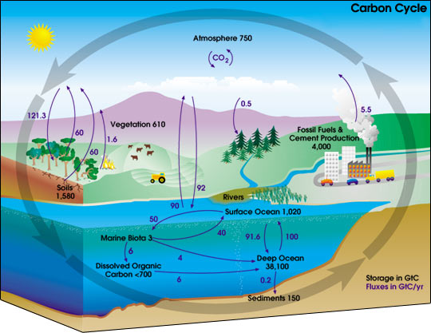
Ecomorality – the Ethics of Sustainability and Evolving Consciousness
BACKGROUND
The Sun provides the energy that drives the carbon cycle, an essential aspect of Life. FACT
7 billion humans are now altering the Carbon Cycle balance by burning fossil fuels (hydrocarbons) and dumping 5.5 gigatons of Carbon into the atmosphere each year. FACT
Plant Life and the Oceans can no longer keep up with this persistent source of CO₂ - so CO₂ levels in the atmosphere are increasing each year. FACT
CO₂ is a known greenhouse gas and affects the heat balance of the planet with the Sun. FACT

Slide 6
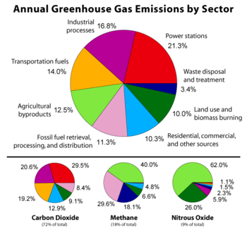
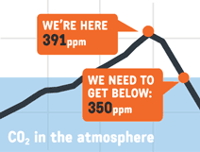
Ecomorality – the Ethics of Sustainability and Evolving Consciousness – an emerging tool for approaching tomorrow’s challenges
Issue: Human Induced Climate Change - Atmospheric Change
After becoming conscious that the Sun is expected to provide life sustaining energy for several more billion years….
After becoming conscious that the Planet Earth is expected to be hospitable for life for at least another 500 million years…
After becoming conscious that Planet Earth has a finite supply of Ancient Sunlight (fossil energy) that will be totally consumed by humans in another 100-150 years… After becoming conscious that 3.8 billion years of evolution created life that subsists directly and indirectly on the daily energy of the Sun…
Isn’t it unethical to continue to consume Ancient Sunlight with no intention of paying it back for future generations to have available?
Isn’t it unethical to produce and eat food that consumes Ancient Sunlight?.........
Note: Re-learning to live off current sunlight allows us to stop burning fossil energy. Human induced climate change due to CO₂ emissions becomes a mute point.

Slide 7
Ecomorality – the Ethics of Sustainability and Evolving Consciousness – an emerging tool for approaching tomorrow’s challenges
Tomorrow’s Challenges (Typical)
Examples of New Ethics to ponder for Sustainable Planet that supports Evolving Consciousness
Isn’t it unethical to “own” land and not harvest the Current Sunlight that falls on that land? (harvesting with natural photoautotroph's, solar panels, wind turbines,…)
Isn’t it unethical to create a waste? (Ref: Cradle to Cradle)
Isn’t it unethical to use an economic model that assumes we can forever borrow finite resources without ever paying them back (or recycling them)?
Isn’t it unethical not to respectfully recycle every atom that one borrows from Planet Earth during our lifetime?
Isn’t it unethical to use an economic model that ignores right relations with the whole of life on the Planet? (Ref: David Korten)
Isn’t it unethical to use an economic model that considers/values only human business transactions? (Ref: David Korten)
Isn’t it unethical to engage in an activities that fail to promote collective learning and evolving consciousness?
Isn’t it unethical to create a force that opposes Right Relations?
Isn’t it unethical to participate in any unsustainable emergence?
Isn’t it unethical to engage in any form of violence? (Here violence is defined as any action that prevents other living species from reaching maturity – their potential)

Slide 8
Reflections on an Ethic of Sustainability
Yesterday’s Successes / Today’s Issues / Tomorrow’s Challenges
Ecomorality – the Ethics of Sustainability and Evolving Consciousness

Slide 9
People & Organizations that can Help You/You can Help (Global)
“Blessed Unrest: How the Largest Social Movement in History Is Restoring Grace, Justice, and Beauty to the World,” by Paul Hawken
…I now believe there are over one—and maybe even two—million organizations working toward ecological sustainability and social justice.
…What I see are ordinary and some not-so-ordinary individuals willing to confront despair, power, and incalculable odds in an attempt to restore some semblance of grace, justice and beauty to this world.
…Groups are intermingling—there are no words to exactly describe the complexity of this web of relationships. The Internet and other communication technologies have revolutionized what is possible for small groups to accomplish and are accordingly changing the loci of power. There have always been networks of powerful people, but until recently it has never been possible for the entire world to be connected.”
For more detail, see: www.wiserearth.org
Also see: Earth Charter www.earthcharterUS.org
Main Areas of Focus
Agriculture and Farming
Air
Animalia
Arts
Biodiversity
Business and Economics
Children and Youth
Civil Society Organizations: Nonprofits,
Coastal and Marine Ecosystems
Community Development
Conservation
Cultural Heritage
Democracy and Voting
Ecology
Education
Energy
Fisheries
Food and Nourishment
Forestry
Global Climate Change
Globalization
Governance
Greening of Industry
Health
Human Rights and Social Justice
Indigenous Peoples and Rights
Inland Water Ecosystems
Law, Policy and Property Rights
Media
Men
Mining
Peace, War and Security
Plants
Pollution
Population
Poverty Eradication
Religion, Ecology, and Sustainability
Seniors
Sustainable Cities
Sustainable Design
Sustainable Development
Technology
Terrestrial Ecosystems
Water
Women
Work

Slide 10
People & Organizations that can Help You/You can Help (National)
Re-build the Dream - Van Jones http://contract.rebuildthedream.com/
To produce this Contract for the American Dream, 131,203 Americans came together online and in their communities. We wrote and rated 25,904 ideas. Together, we identified the 10 most critical steps to get our economy back on track and restore the American Dream:
I. Invest in America's Infrastructure
II. Create 21st Century Energy Jobs
III. Invest in Public Education
IV. Offer Medicare for All
V. Make Work Pay
VI. Secure Social Security
VII. Return to Fairer Tax Rates
VIII. End the Wars and Invest at Home
IX. Tax Wall Street Speculation
X. Strengthen Democracy

Slide 11
People & Organizations that can Help You/You can Help (UUA)
Ministry for Earth
About UUMFE
Connecting and inspiring an active community of UUs for environmental justice, spiritual renewal, and shared reverence for our Earth home.
Vision
We envision a world in which reverence, gratitude, and care for the living Earth are central to the lives of all people. Our purpose is to inspire, facilitate, and support personal, congregational, and denominational practices that honor and sustain the Earth and all beings. We affirm and promote the seven principles of the UUA, including: “Respect for the interdependent web of all existence of which we are a part.”
The UU Ministry for Earth, All Souls Unitarian in Washington, DC and other national and local UU groups are joining with interfaith leaders from Jewish, Catholic, Christian, and Buddhist communities on August 28th and 29th to protest the construction of the Keystone XL Pipeline (also known as the Tar Sands).
The Tar Sands Pipeline will be built across the US from Canada. First Nations communities in Canada and tribes along the pipeline route in the U.S. have demanded the destruction cease. Concerns about the Tar Sands Pipeline include the risky extraction methods, the dangers of the pipeline itself, and the long-term climate change consequences.

Slide 12
People & Organizations that can Help You/You can Help (UUA)
The Green Sanctuary Program - Congregations and congregants working together to restore Earth and renew Spirit.
Designed to give roots and wings to the vision that, together, we can create a world in which all people make reverence, gratitude, and care for the living Earth that is central to our lives.
Provides a framework for congregations and congregants to proclaim and live out their commitment to the Earth.
Provides the framework for congregations to begin specific projects and activities that lead to recognition as a Green Sanctuary through candidacy and then accreditation.
Invites congregations to embark on an exploration of what it means to live today within a religious community on an imperiled Earth.
Is a way for all Unitarian Universalists to join efforts, both symbolically and explicitly, in becoming stewards of the Earth.
The newest version of the Green Sanctuary Manual is now available online!

Slide 13
People & Organizations that can Help You/You can Help (First Universalist, Denver)
Green First Teams / Social Justice Task Forces
First Universalist Church has received official recognition for completing the UUA Green Sanctuary Program.
We have agreed to live out our commitment to the Earth by creating sustainable lifestyles for our members as individuals and as a faith community.
We are committed to creating a religious community that has a fundamental, bottom-line, commitment to living in harmony with the Earth.
For more information, contact Tom Abood ( tabood@dsl-mail.com )

Slide 14
A Typical Personal Response to New Ethics?
Reflection
After watching the documentary film “Gasland” that describes hydraulic fracking of the deep earth to release the natural gas so it can be extracted, something changed within me.
When I became conscious of the irreparable damage to earth, to the millions of gallons of water mixed with undisclosed (proprietary) toxic fracking chemicals pumped into the earth needed to fracture her thousands of feet underground, something changed within me.
When I became conscious that a significant amount of this contaminated water comes gushing back out of these wells during the process, often spilling into nearby streams or infiltrating aquifers used for drinking water, I was changed.
When I learned about the damage to the air as this contaminated water is held in ponds to allow the toxic chemicals to evaporate into the air, just so I could have natural gas piped to me to burn for heating water and my home, something changed within me.
Mary Oliver said it best:
One day you finally knew what you had to do, and began, though the voices around you kept shouting their bad advice…
~ Mary Oliver, The Journey, Dream Works ~

Slide 15
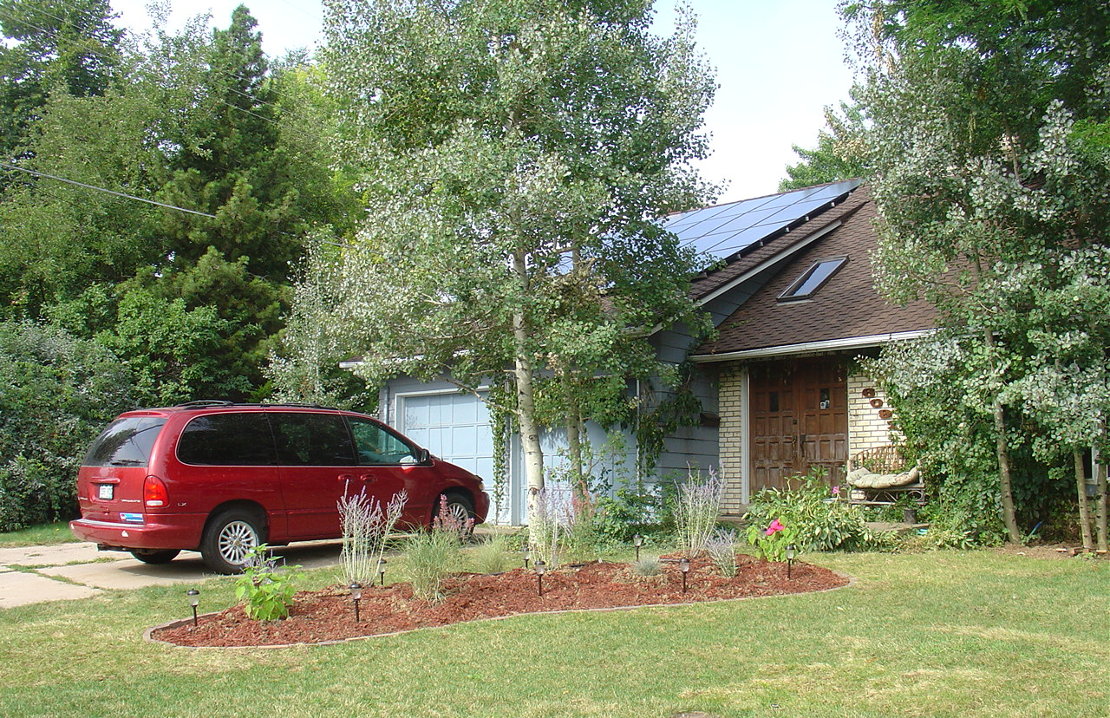
A Typical Personal Response to the New Ethics
Principle: It is unethical to consume Ancient Sunlight (except in an effort to avoid using Ancient Sunlight)
Response: (by using the power of consumerism, we can: )
Phase 1: Generate all electrical power from the Sun – no coal or natural gas
Phase 2: Utilize a geothermal heat pump for heating & cooling – no natural gas
Phase 3: Drive an electric car for all local transportation – no gasoline or diesel
Phase 4: Begin growing food in a back yard garden - avoid using fossil energy
SOLAR HOME
Phase 1: Add Photovoltaic Solar Panels for Electrical Power –COMPLETED 2011
Phase 3: Replace with plug-in electric car
2012
Phase 2: Add Geothermal Heat Pump for heating and cooling – COMPLETED 2011

Slide 16
Resources (Used by Milt)
Benyus, Janine. Biomimicry: Innovation Inspired by Nature, Harper Perennial, 2002.
Brown, Cynthia Stokes. Big History: From the Big Bang to the Present. The New Press, 2007.
Chaisson, Eric. Epic of Evolution: Seven Ages of the Cosmos. Columbia University Press, 2005
Chamberlin, Shaun. The Transition Timeline: For a local, resilient Future.
Chelsea Green Publishing, 2009.
Christian, David. Maps of Time: An Introduction to Big History. University of California Press, 2005.
Cohen-Kiener, Andrea. Claiming Earth as Common Ground : The Ecological Crisis through the Lens of Faith. Skylight Paths Publishing, 2009.
Corzine, Amy. The Secret Life of the Universe: The Quest for the Soul of Science.
Watkins Publishing, 2008.
Ferris, Timothy. Coming of Age in the Milky Way. Perennial, 2003.
Korten, David. Agenda for a New Economy: From Phantom Wealth to Real Wealth – Why Wall Street
Can’t be Fixed and How to Replace it. BK Publishers, 2009.
Kowalski, Gary. Science and the Search for God. Lantern /books, 2003.
McDonough, William & Michael Braungart. Cradle to Cradle: Remaking the Way We Make Things. North Point Press, 2002.
Nierenberg, Danielle & Brian Halweil,. 2011 State of the World: Innovations that Nourish the Planet, Worldwatch Institute Report, W. W. Norton & Company, 2011.
Rue, Loyal. Everybody’s Story: Wising Up to the Epic of Evolution.
State University of New York Press, 2000.
Schuler, Michael. Making the Good Life Last: Four Keys to Sustainable Living. BK Publishers, 2009.
Smith, Philip & Manfred Max-Neef. Economics Unmasked : From Power and Greed to Compassion and the Common Good. Green Book, 2011.
Wells, Spencer. The Journey of Man: A Genetic Odyssey. Random House, 2003

Slide 17
Reflections on “What Does Your Element Want of You?”
What is the Life that wants to live in you?
What change might you make in your personal life in the next month?

